Slide 1
Railroads and the Raj: Estimating the Impact of Transportation Infrastructure
Dave Donaldson, AER forthcoming

Slide 2
Aims to Estimate the effects of reductions in transport costs
Example of the railroads built in colonial India 1853-1930where transportation previously had been by bullocks

Slide 3
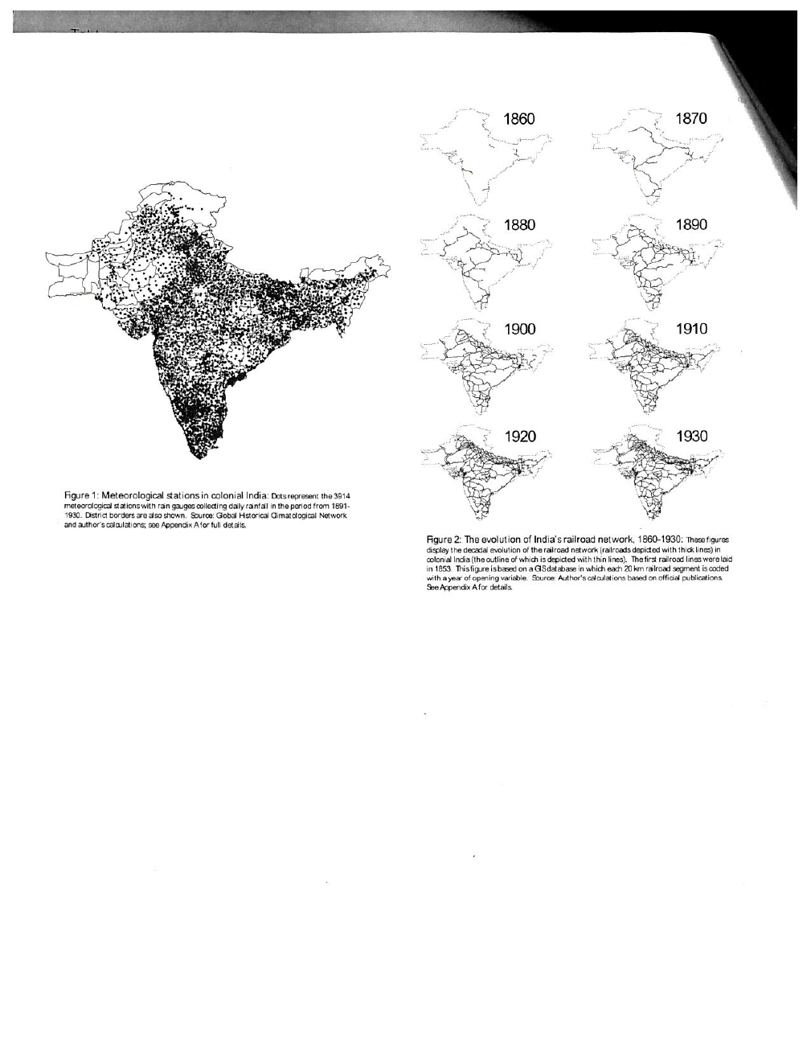

Slide 4
Data and Findings
Detailed data on when each 20 km segment of the rr opened and prices, rainfall etc, agricultural production, prices for each of 17 crops, intraregional trade; also considers rivers, had not been much irrigation so raifall shocks were key and over 3600 rainfall stations
Makes use of a general equilibrium model
1. Making use of the differences in prices between origin and other dstricts
2. Bilateral trade flows estimated with gravity model revealing impacts of transprot cost reductioons
3. Showing rrs reduce the response of prices to local productivity shocks such as rainfall

Slide 5
More findings
4. RRs. Increases real income levels of districts, once connected . Own rr. Increases real income by 18% , a neighbor’ access reduces yours by 4%
5. RR decreases real income volatility. Incomes less vulnerable to local productivity shocks
6. Decreased trade costs account for almost all of the rise in real income
Methods: deal with non-random treatment, capture general equilibrium effects

Slide 6
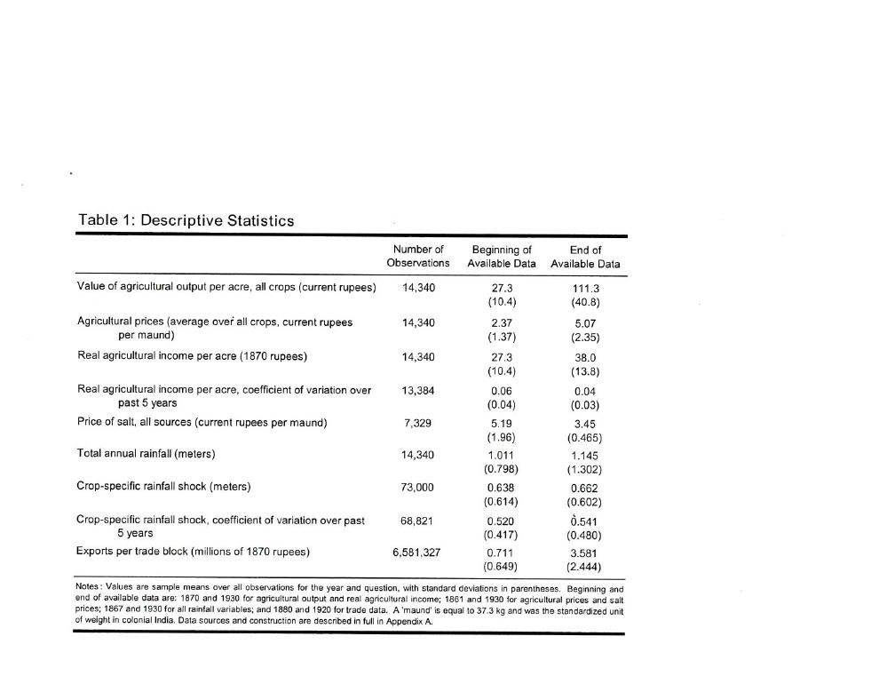

Slide 7
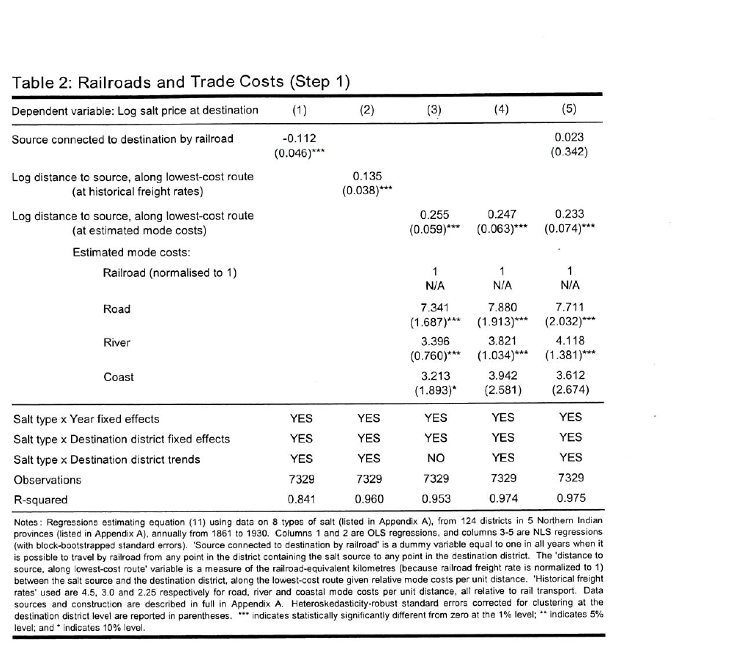

Slide 8
Note from Table 2
That the costs of salt is much higher when transported by road or even river compared to via railroad, even after controlling for salt type etc.
Then in Table 3 note how distance reduces trade flows (exports ) but that the percentage of origin and destination districts served by rrs. Raises this

Slide 9
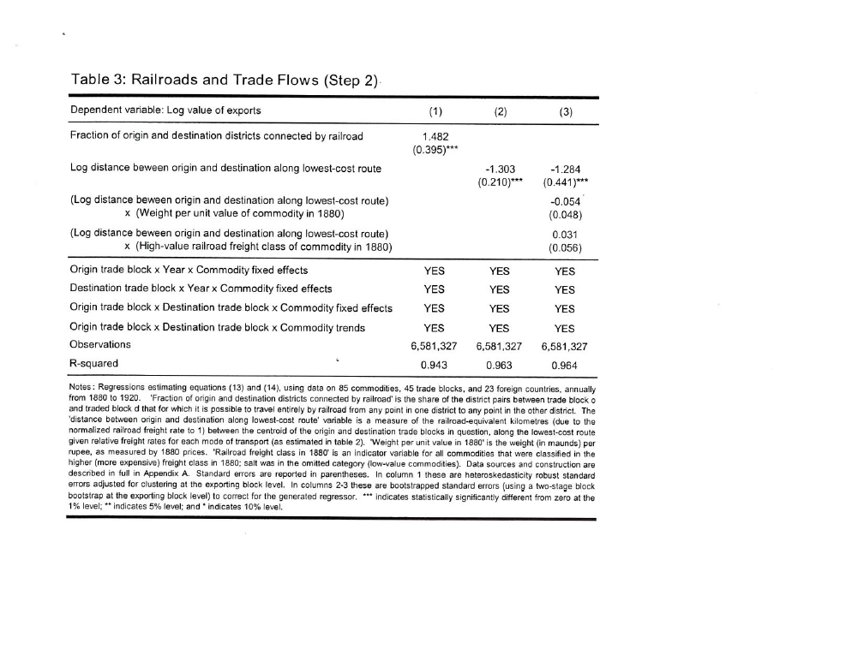

Slide 10
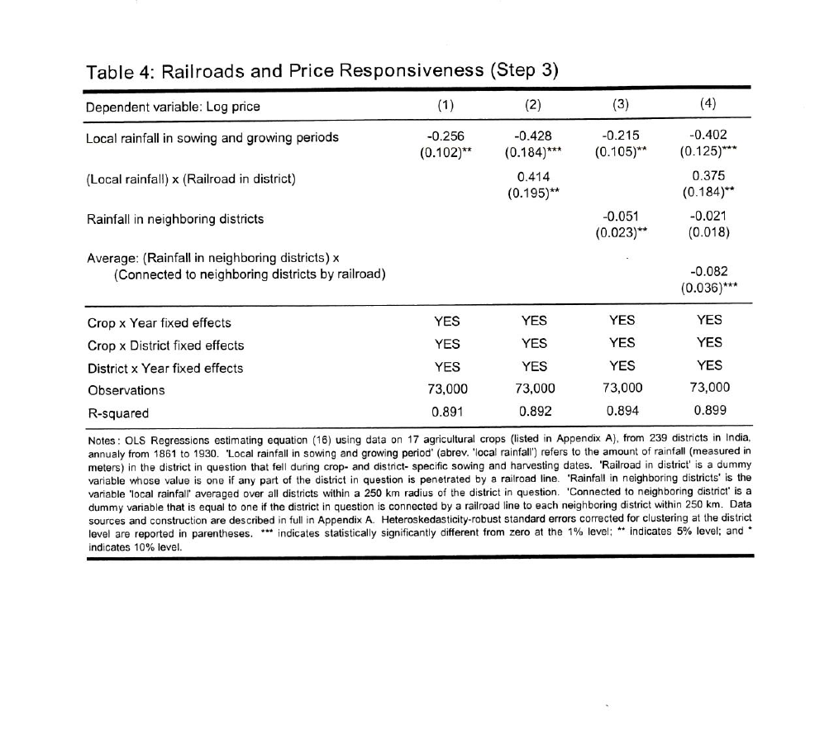

Slide 11
Notes from Table 4
See how rainfall in the district lowers price but if that district is served by railroad, the positive impact of this exactly counterbalances the negative effect of district rainfall on price.
TABLE 5
Shows that real aggregate agricultural income is significantly raised by rr in district, slightly negatively affected by rr in neighboring district

Slide 12
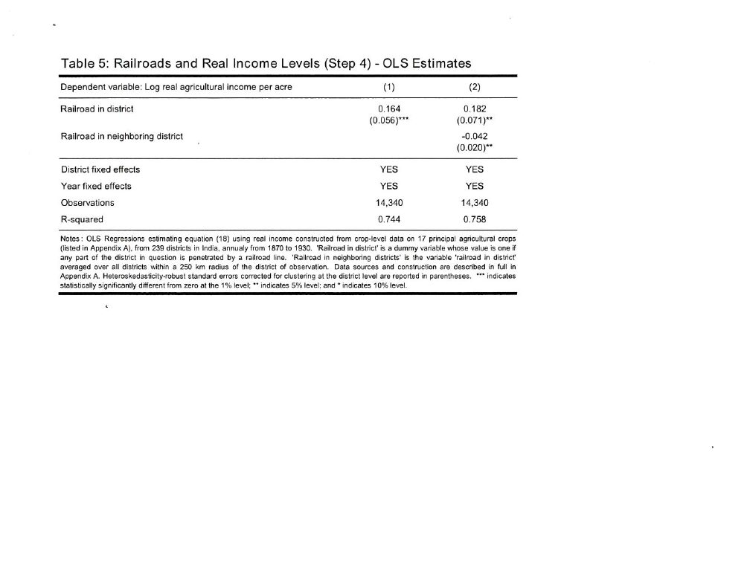

Slide 13
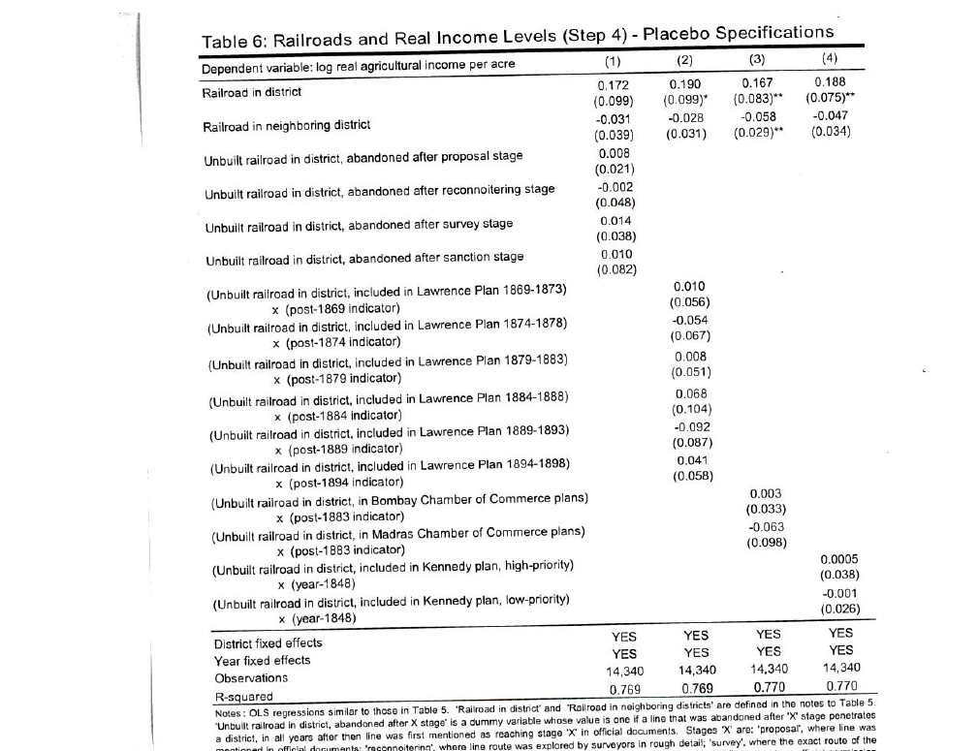

Slide 14
Table 6
The different specifications represent placebo teststo see whether the estmates in the top row of the rr on real agricultural income per acre would have been affected by other non built but sometimes planned and studies rr segments. The outcomes were therefore unlikely to be affected by purposive developmental effects (endogeneity)
Table 7 uses a two stage approach, first likelihood of rr and then real agricultural income per acre, seeking to see whether motivation forbuilding rr might be mixed up and whether a major drought of 1876-8 might have long lasting effects (with ten year lags). IV estimate effect very similar to the OLS estimates. Both rr and rainfall have positive effects on reala agric. Income

Slide 15
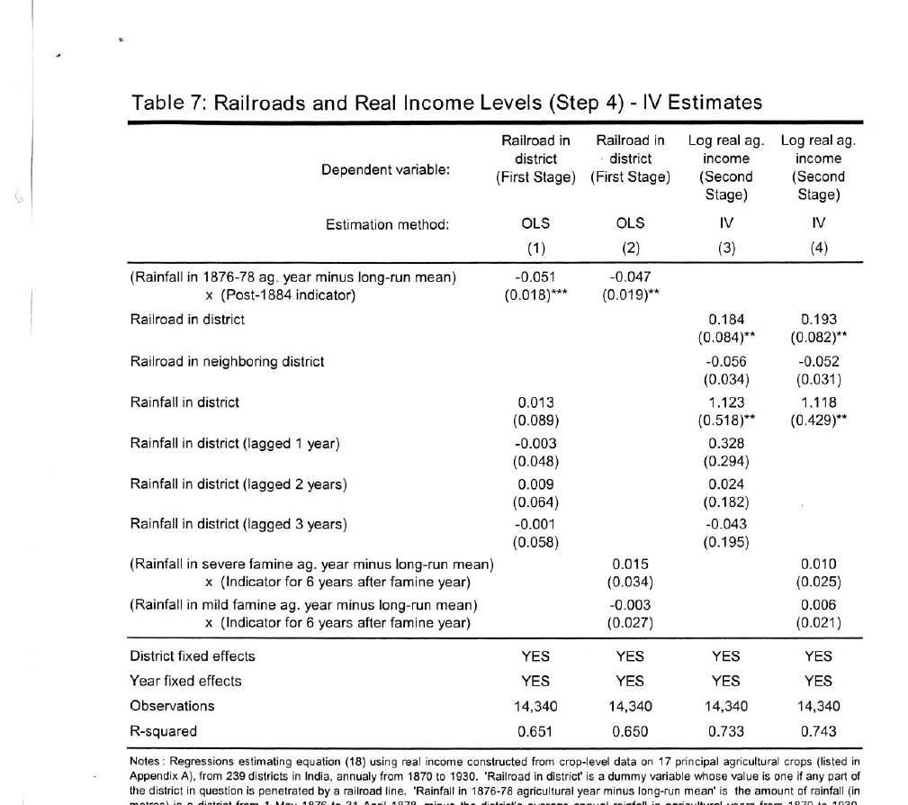

Slide 16
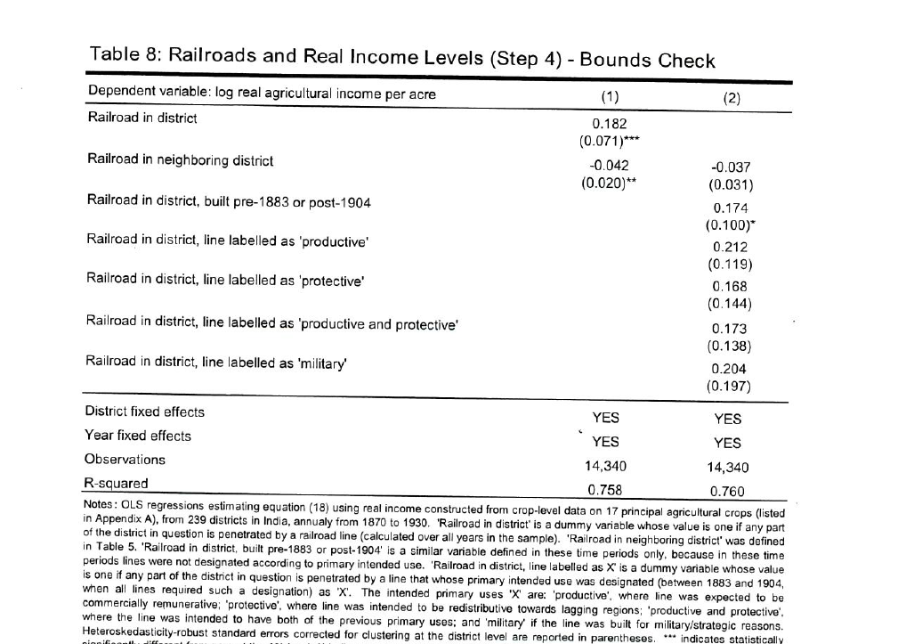

Slide 17
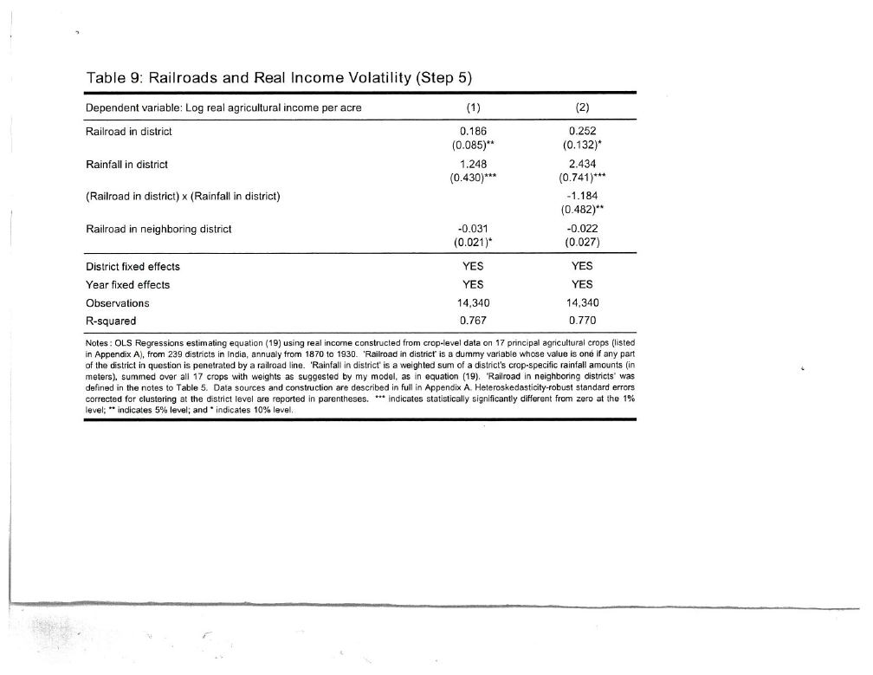

Slide 18
Tables 8,9
Table 8 is like earlier ones in showing that different reasons or special aspects of rr, such as military, have little effects, all have similar effects. Effects of “productive” ones do have slight larger effects than those built for protective reasons
Table 9 shows that both rainfall and rairod in district have significant positive effects on real income, but these are to some extent substitutes

Slide 19
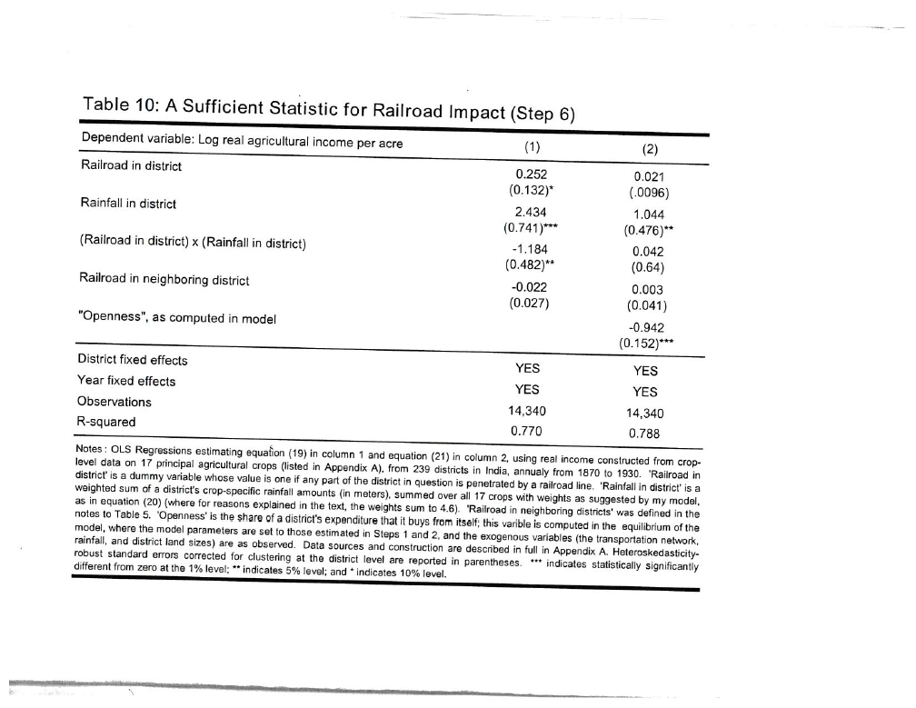

Slide 20
Table 10
Note that the effect of rainfall on real agricultural income per acre is larger before railroad since the interaction term with rr is negative
The results in column (2) show that when “openness is added, i.e., the percentage of output that is marketed locally , the positive effects of both rainfall and railroad are both lower.

